Slide 1
Environmental-Economic Accounting in Canada
Regional Seminar on the System of Environmental-Economic Accounts (SEEA) Central Framework in the Caribbean
February 6-7, 2014
Castries, Saint Lucia
Joe St. Lawrence
Statistics Canada

Slide 2
Integrating the Environment and the Economy at Statistics Canada
First edition of Human Activity and the Environment
1989 Waste Management Industry Survey
Survey of Environmental Protection Expenditures
Environment Industry Survey
1997 Canadian System of Environment and Resource Accounts (CSERA)
Environment and Sustainable Development Indicators
2005 Agricultural Water Use Survey
2007 Survey of Industrial Water Use
2009 Survey of Drinking water Treatment Plants
2013 Measuring Ecosystem Goods and Services project results published in Human Activity and the Environment.

Slide 3
The Economy
-Natural Resources
-Ecosystem Services
-Residuals
and The Environment
Stocks
The
Economy
Flows
Expenditures

Slide 4
SNA view
Industries
Final demand
Assets
Sectors
Financial and produced assets, opening balance
Industrial output of goods and services
Industrial intermediate demand
Final demand
Gross fixed capital formation
Commodities
Wastes
Other changes in volume & holding gains/losses on financial & produced assets
Sectors
Financial and produced assets, closing balance

Slide 5
SEEA view
Industries
Final demand
Assets
Sectors
Financial and produced assets, opening balance
Natural resource assets, opening balance
Natural resource assets, opening balance
Industrial output of goods and services
Industrial intermediate demand
Final demand
Gross fixed capital formation
Environmental protection expenditures
Environmental protection expenditures
Capital expenditures for environmental protection
Commodities
Resource production by industries
Resource production by households/gov’t
Resource use by industries
Resource use by households/gov’t
Waste consumption by industries
Waste consumption by households/gov’t
Wastes
Waste output by industries
Waste output by households/gov’t
Other changes in volume & holding gains/losses on financial & produced assets
Changes in and holding gains/losses on natural resource assets
Changes in natural resource assets
Sectors
Financial and produced assets, closing balance
Natural resource assets, closing balance
Natural resource assets, closing balance

Slide 6
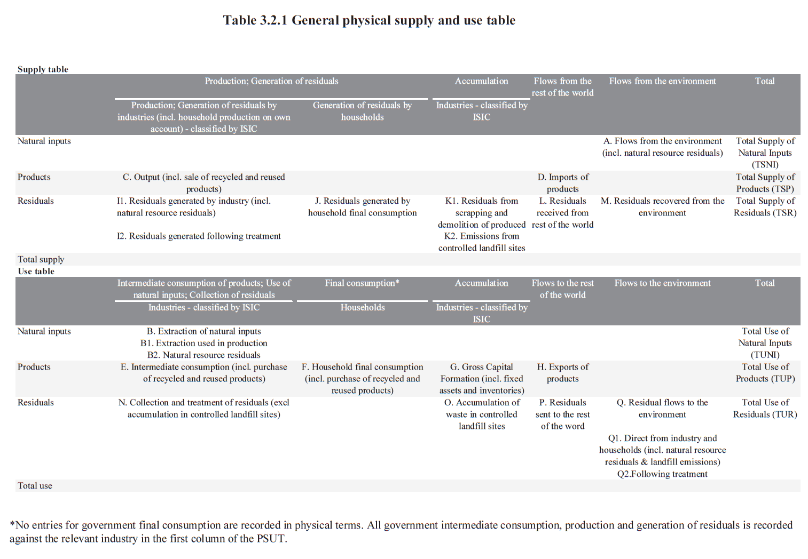
Flow Accounting
United Nations, 2012, System of Environmental-Economic Accounting: Central Framework (white cover draft), New York. http://unstats.un.org/unsd/envaccounting/White_cover.pdf

Slide 7
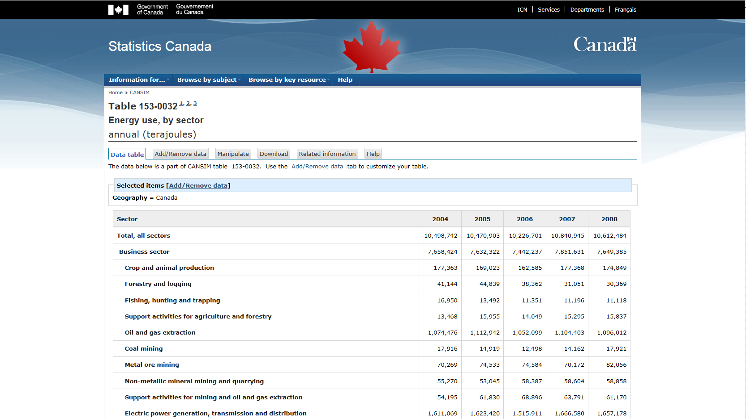
Energy Flow Accounting

Slide 8
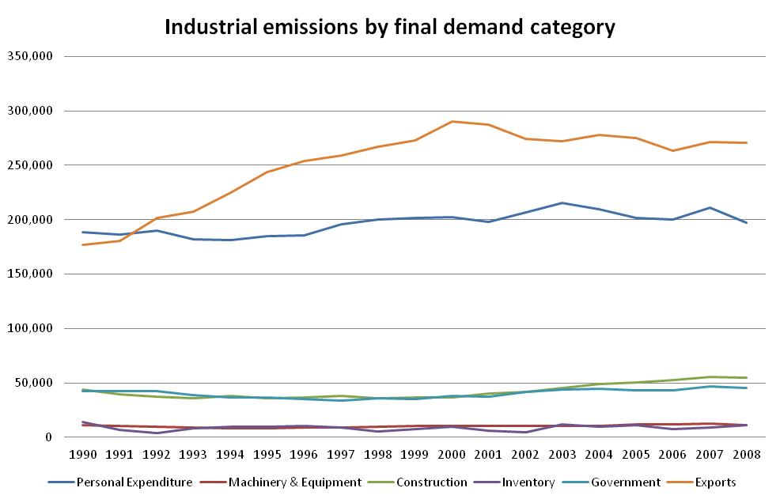
Residuals Flow Accounting

Slide 9
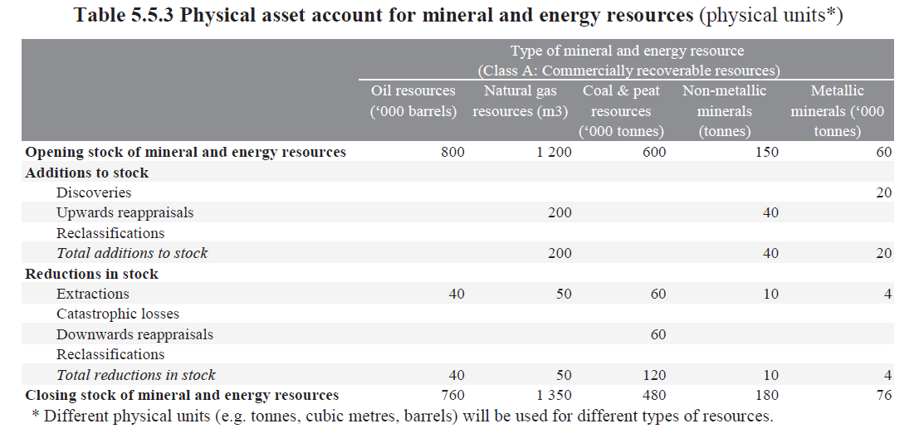
Asset Accounting
United Nations, 2012, System of Environmental-Economic Accounting: Central Framework (white cover draft), New York. http://unstats.un.org/unsd/envaccounting/White_cover.pdf

Slide 10
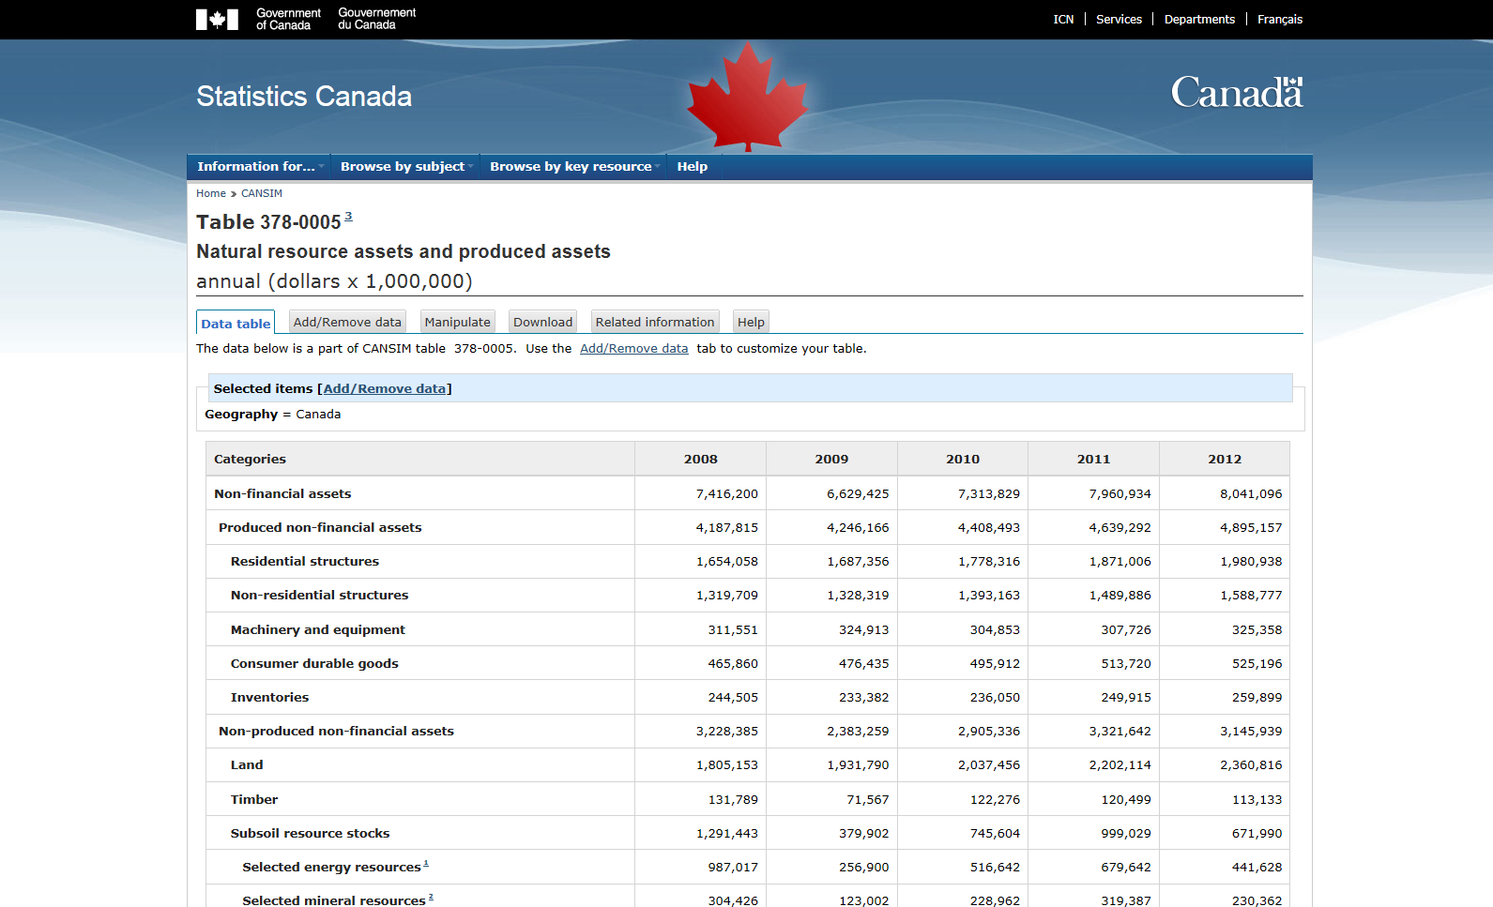
Asset Accounting

Slide 11
Canada’s Natural Resource Wealth

Slide 12
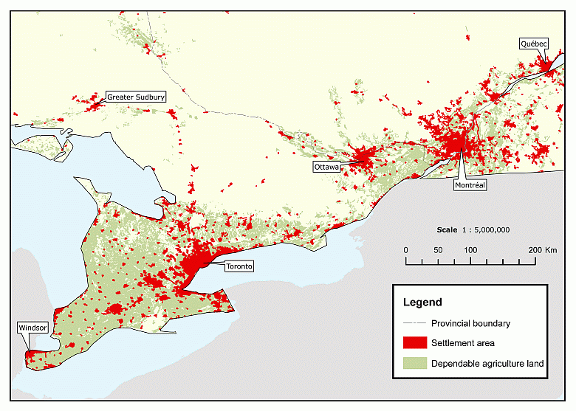
Settlements and Dependable Agricultural Land, 2006
Notes:
Land accounting. Land use change matrices. Steps towards ecosystem service accounting.

Slide 13
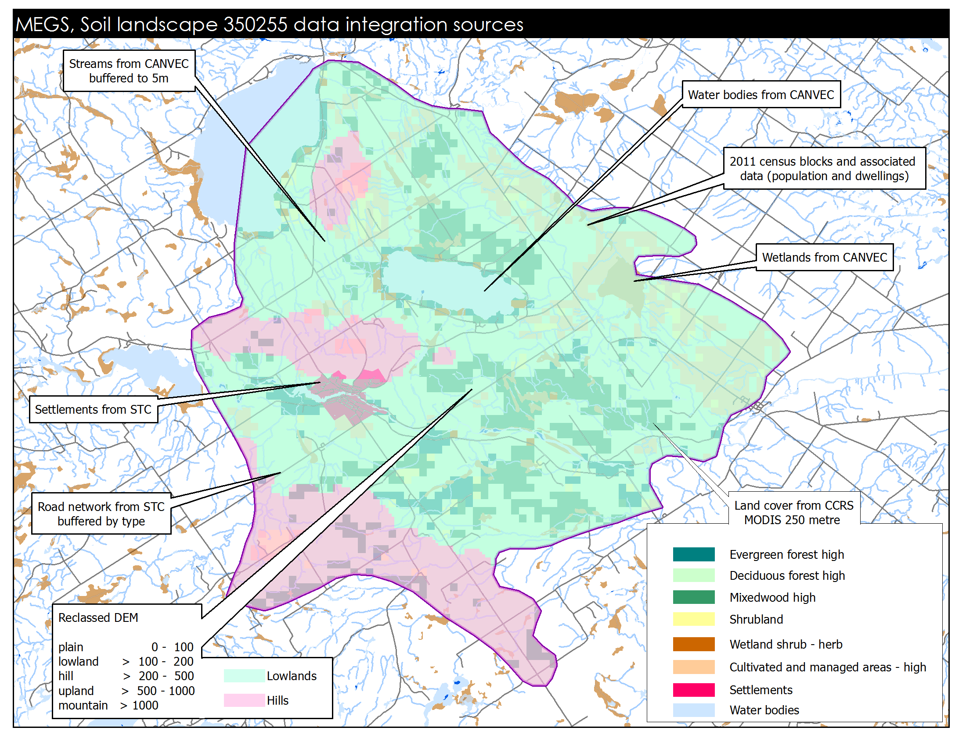
Measuring Ecosystem Goods and Services

Slide 14
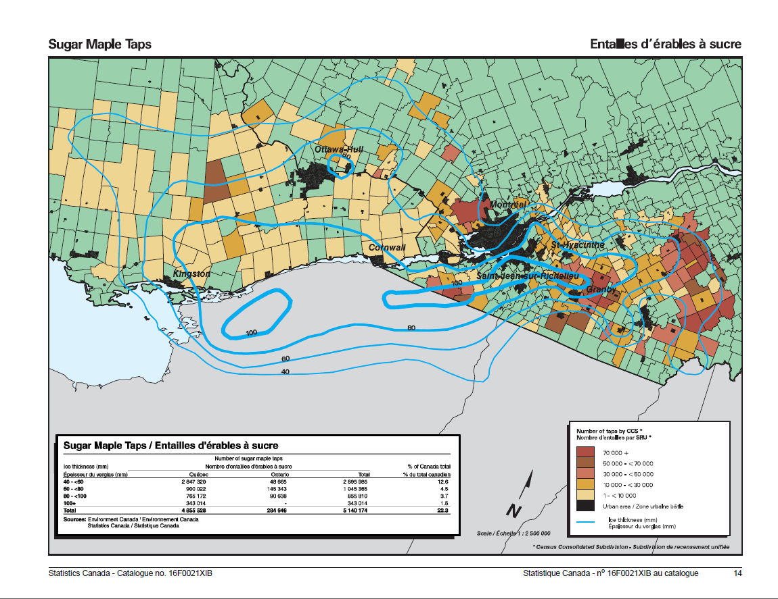
Notes:
Applications of land data: The 1998 Ice Storm

Slide 15
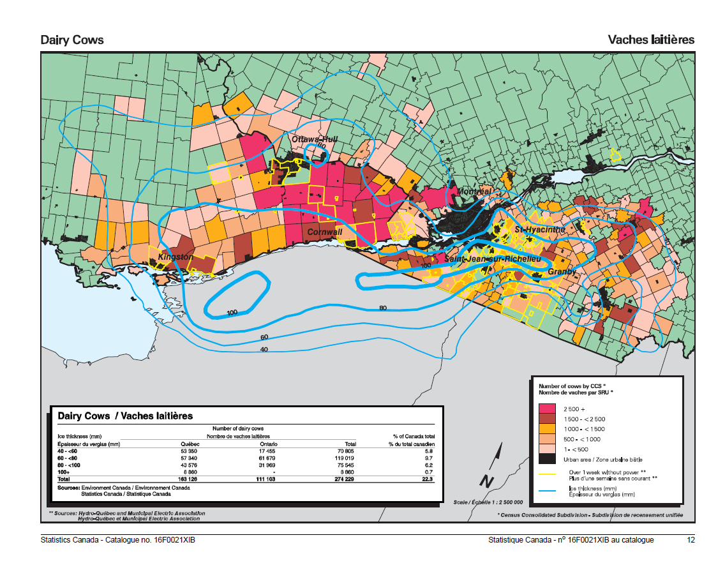

Slide 16
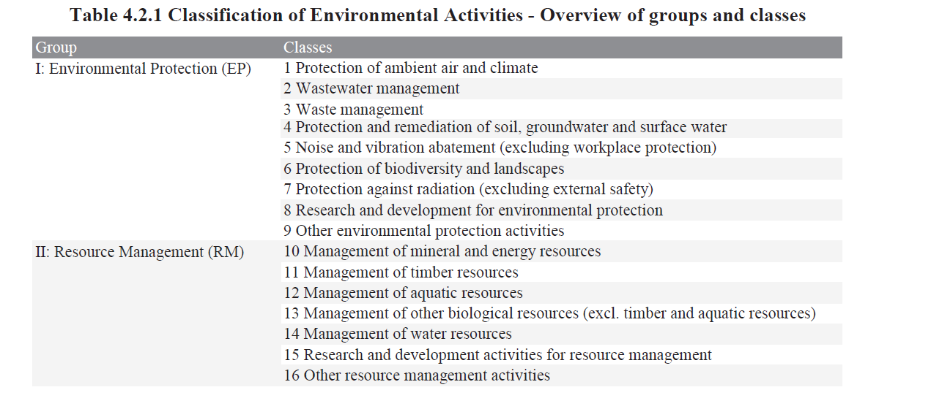
Accounting for Environmental Transactions
United Nations, 2012, System of Environmental-Economic Accounting: Central Framework (white cover draft), New York. http://unstats.un.org/unsd/envaccounting/White_cover.pdf
Notes:
Basic domains of statistics. Can be looked at from the supply side (EGSS) or the demand side (EP and RM expenditures)

Slide 17
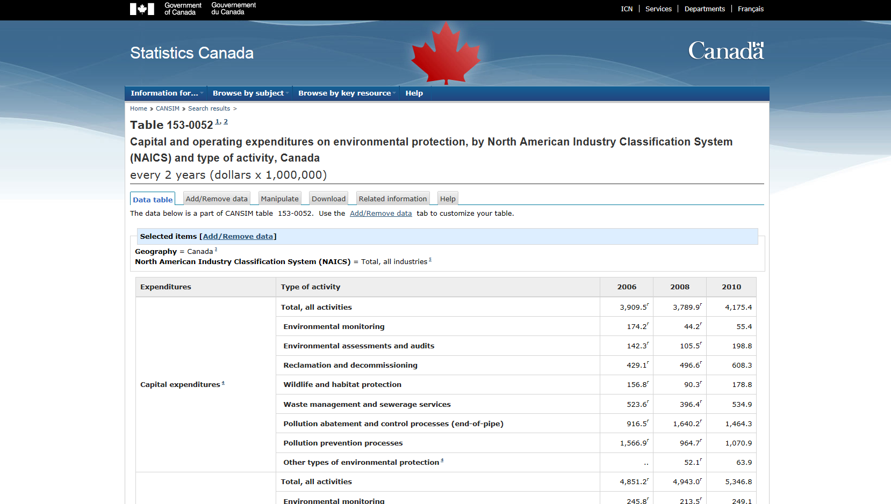
Accounting for Environmental Transactions

Slide 18
Current and future work at Statistics Canada related to SEEA
Continue role as chair of the London Group
SEEA implementation
SEEA research agenda
Encourage coordination of efforts in this domain
Participate in the Steering Committee for the SEEA Central Framework Research Agenda
Expand environmental accounts based on data gaps identified in the new Framework for Environment Statistics.

Slide 19
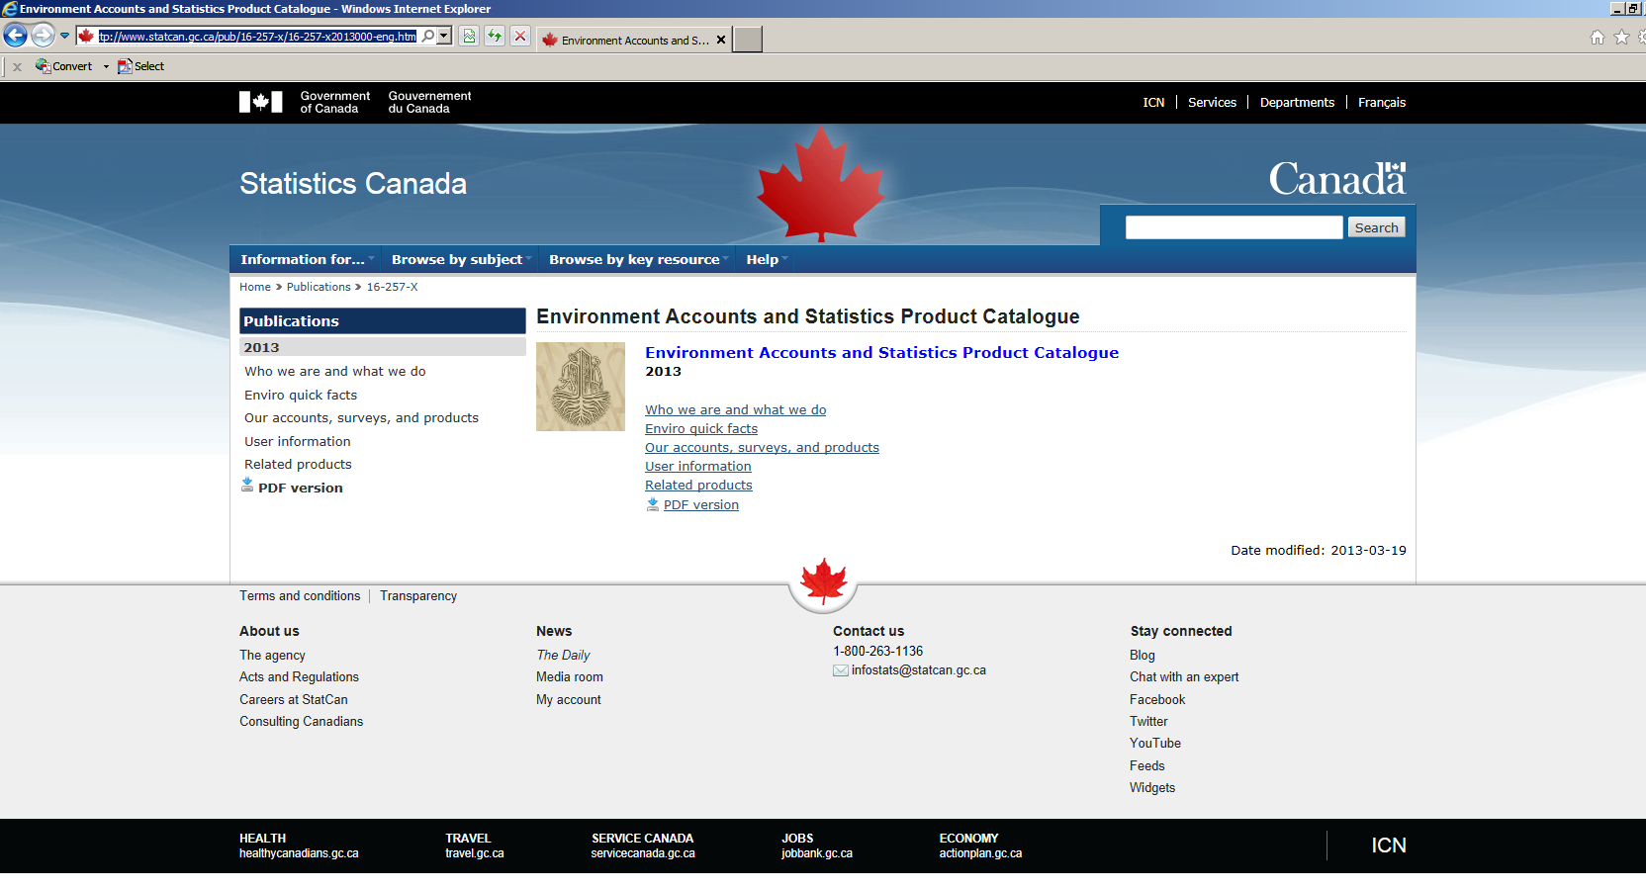
Environment Accounts Product Catalogue
http://www.statcan.gc.ca/pub/16-257-x/16-257-x2013000-eng.htm

Slide 20
Questions?
Joe St. Lawrence
Environment Accounts and Statistics | Comptes et statistique de l'environnement
R.H. Coats Building | Immeuble R.-H.-Coats / Floor | Étage 25 M
Statistics Canada | 100 Tunney's Pasture Driveway, Ottawa ON K1A 0T6
Statistique Canada | 100, promenade Tunney's Pasture, Ottawa ON K1A 0T6
Joe.St.Lawrence@statcan.gc.ca
Telephone | Téléphone 613-951-7709
Facsimile | Télécopieur 613-951-0634
Government of Canada | Gouvernement du Canada

Slide 21
“Beyond GDP”
“What we measure affects what we do; and if our measurements are flawed, decisions may be distorted. Choices between promoting GDP and protecting the environment may be false choices, once environmental degradation is appropriately included in our measurement of economic performance. So too, we often draw inferences about what are good policies by looking at what policies have promoted economic growth; but if our metrics of performance are flawed, so too may be the inferences that we draw.”
Stiglitz, J.E., A. Sen, and J-P. Fitoussi, (2009), Report by the Commission on the Measurement of Economic Performance and Social Progress, p.7
www.stiglitz-sen-fitoussi.fr/documents/rapport_anglais.pdf
Notes:
Metrics of performance: not necessarily flawed, but at a different scope. Economy in isolation vs bigger picture.

